Slide 1
AZ-900 Workshop Part Deux
20 questions discussed in 15 -30 minutes

Slide 2
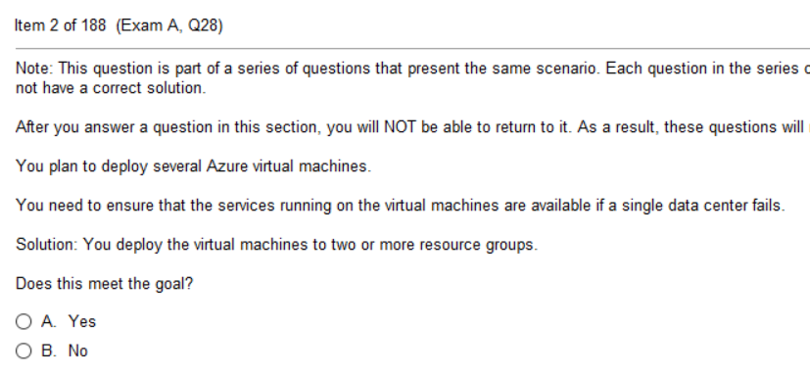
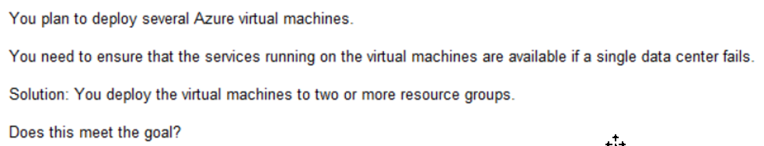
Q1

Slide 3
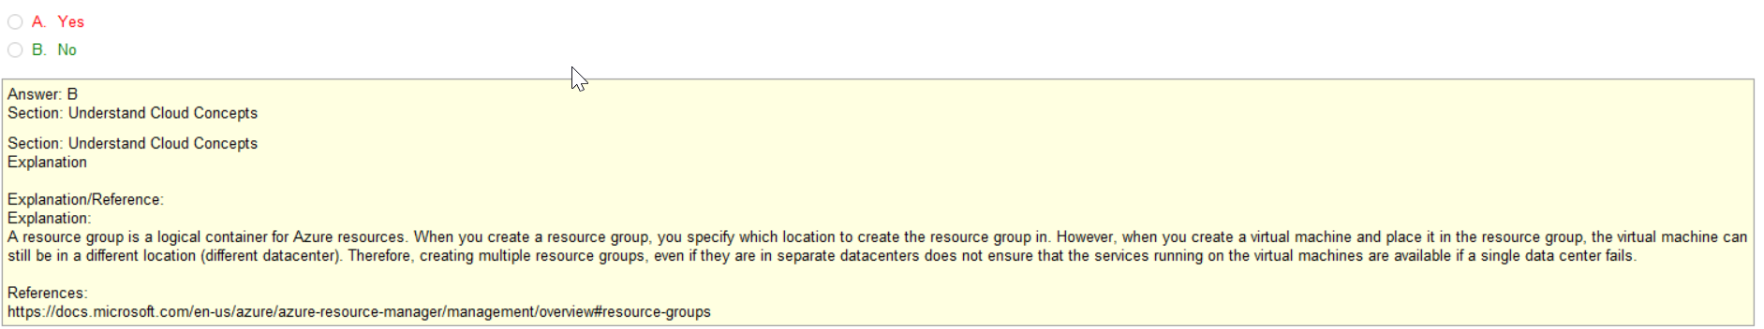

Slide 4
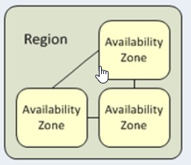
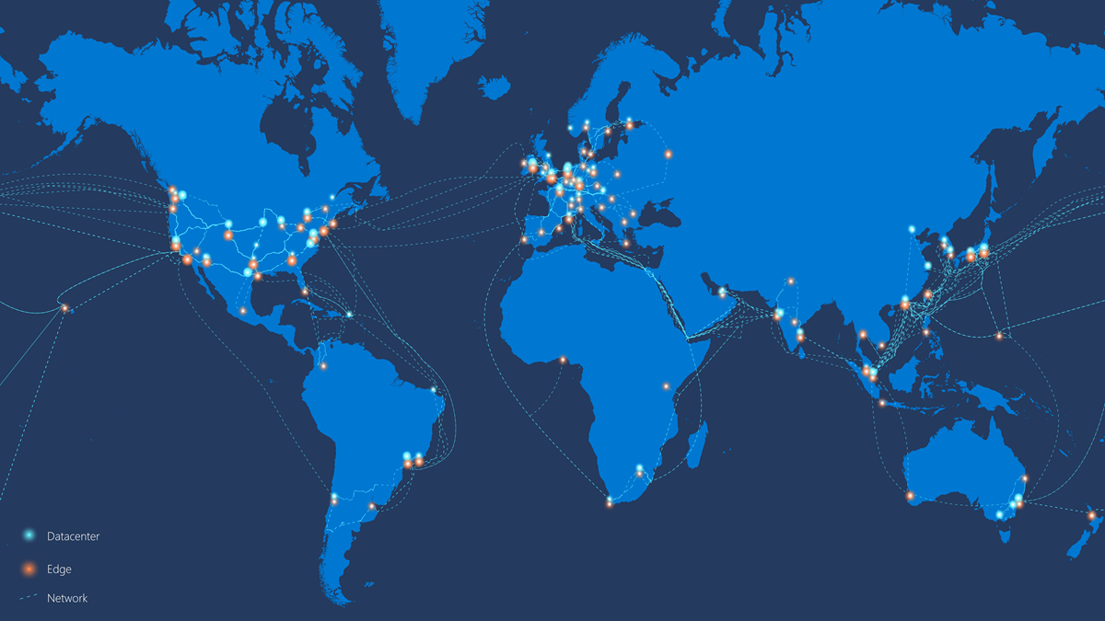
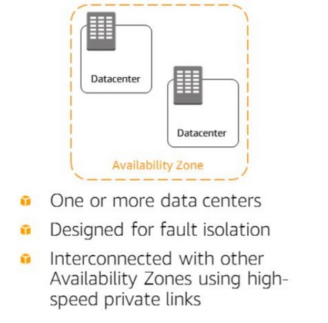
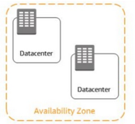
Azure Regions
CDN
Edge
Edge

Slide 5
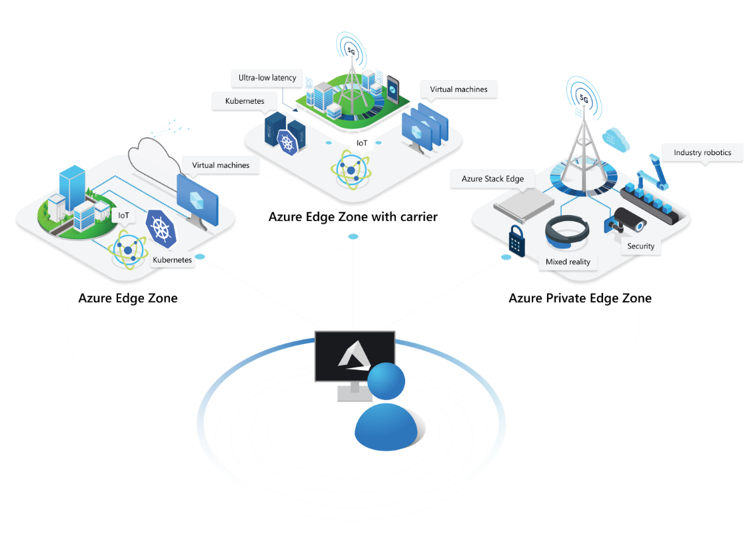
Azure Edge
Azure Edge Zones are small-footprint extensions of Azure placed in population centers that are far away from
Azure regions.
Azure Edge Zones support VMs, containers, and a selected set of Azure services that let you run latency-sensitive and throughput-intensive applications close to end users.
Azure Edge Zone is a family of offerings that enables data processing close to the user. You can deploy VMs, containers, and other selected Azure services into Edge Zones to address the low latency and high throughput requirements of applications.

Slide 6
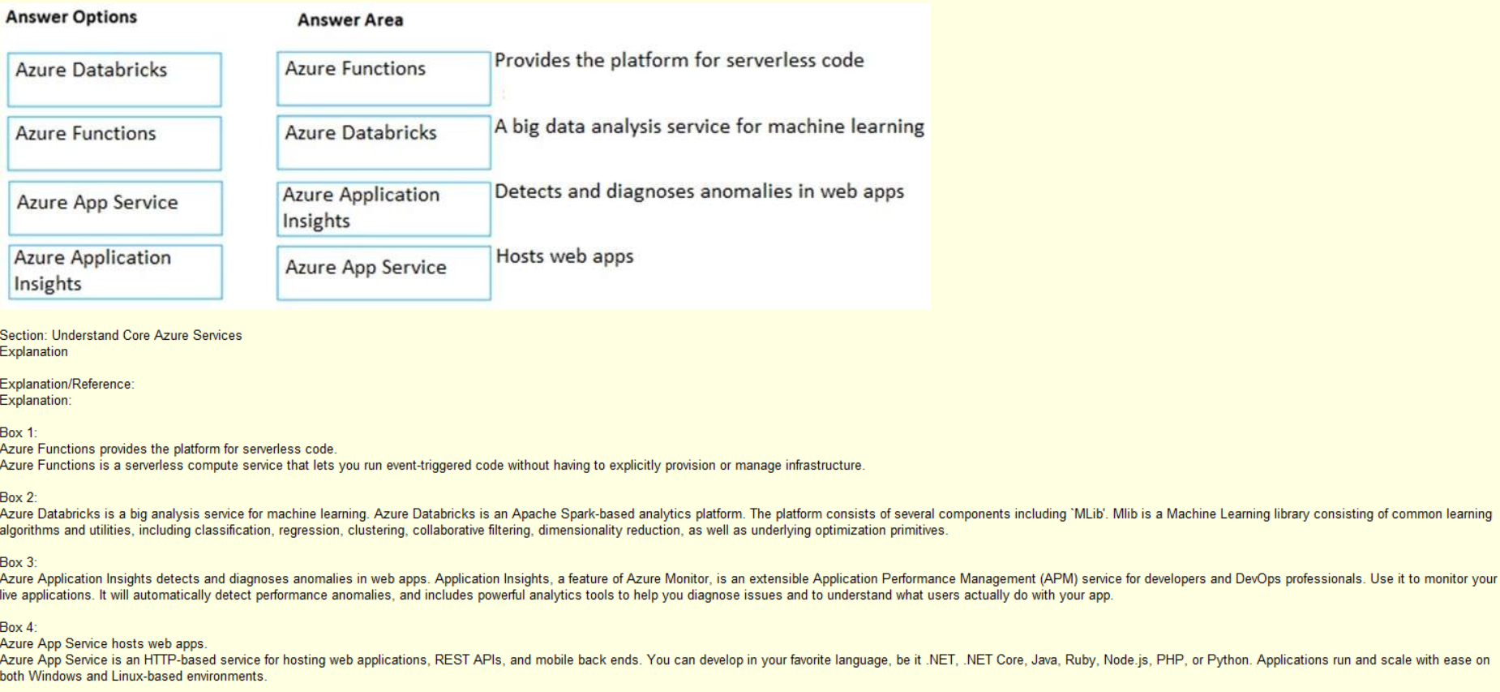
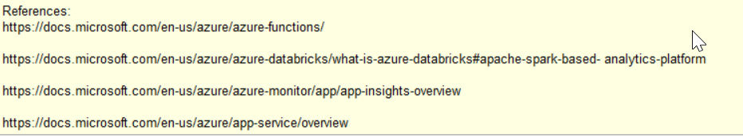
Q3

Slide 7
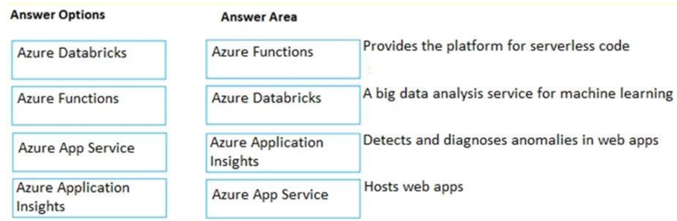
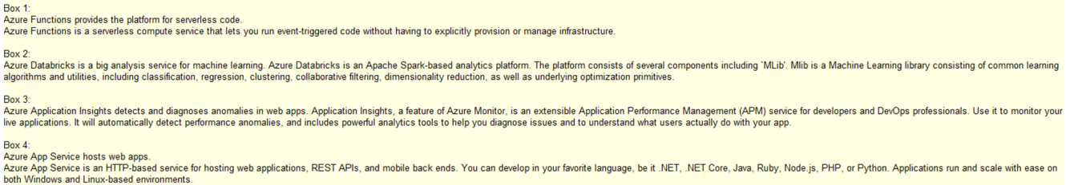

Slide 8
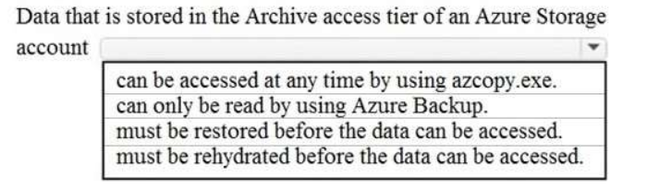
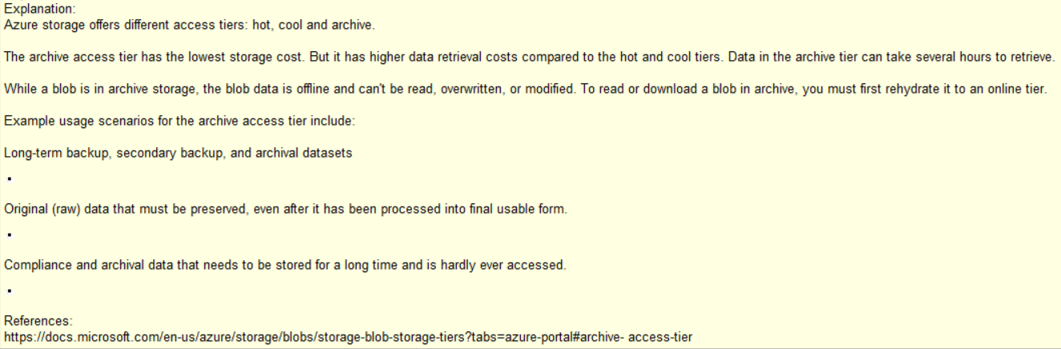
Q4

Slide 9
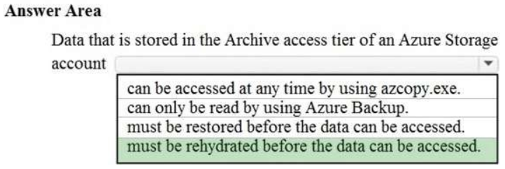

Slide 10
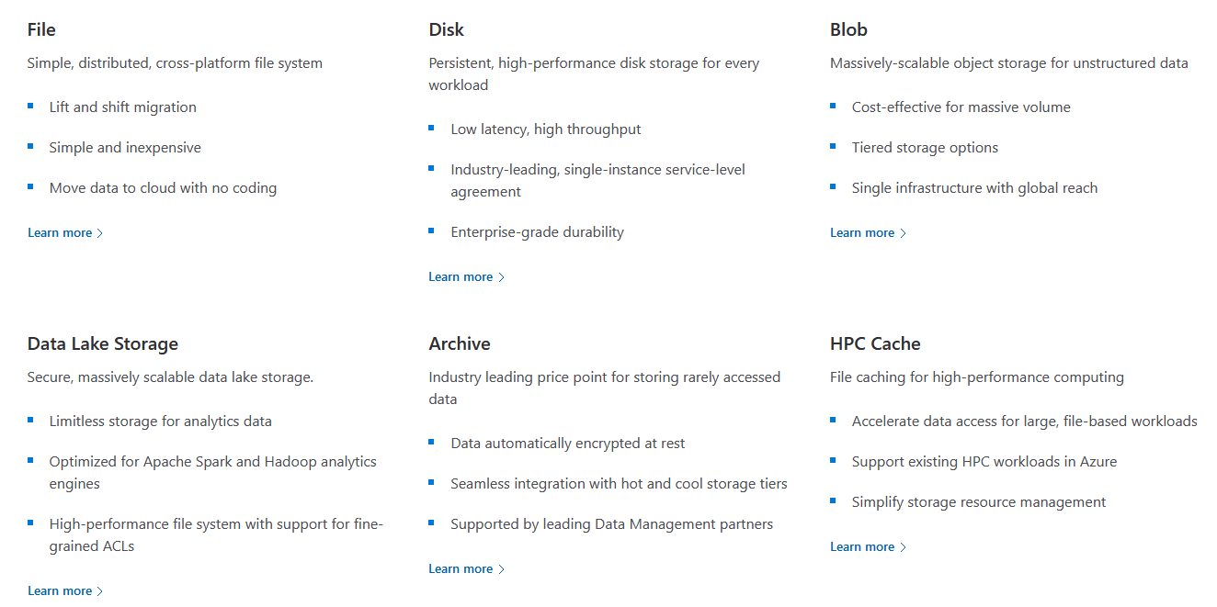
Classification Types of Azure Storage

Slide 11
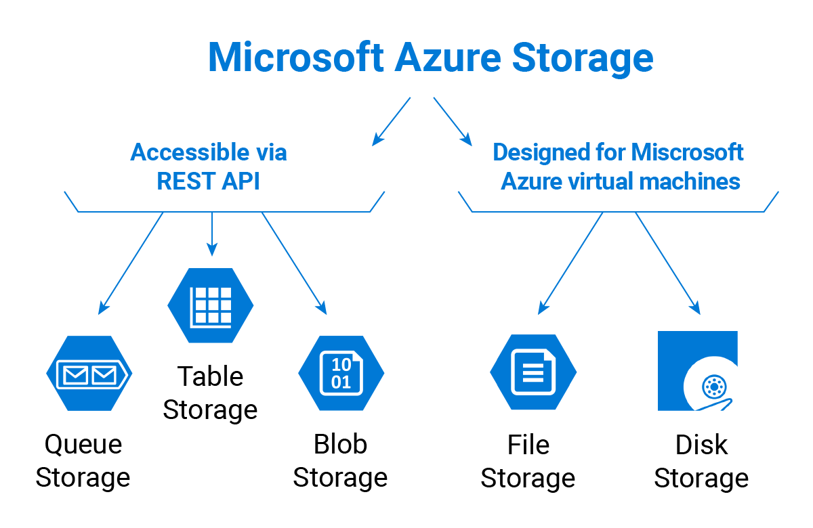

Slide 12
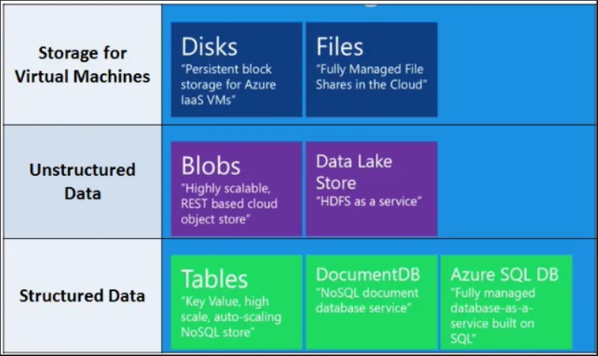

Slide 13
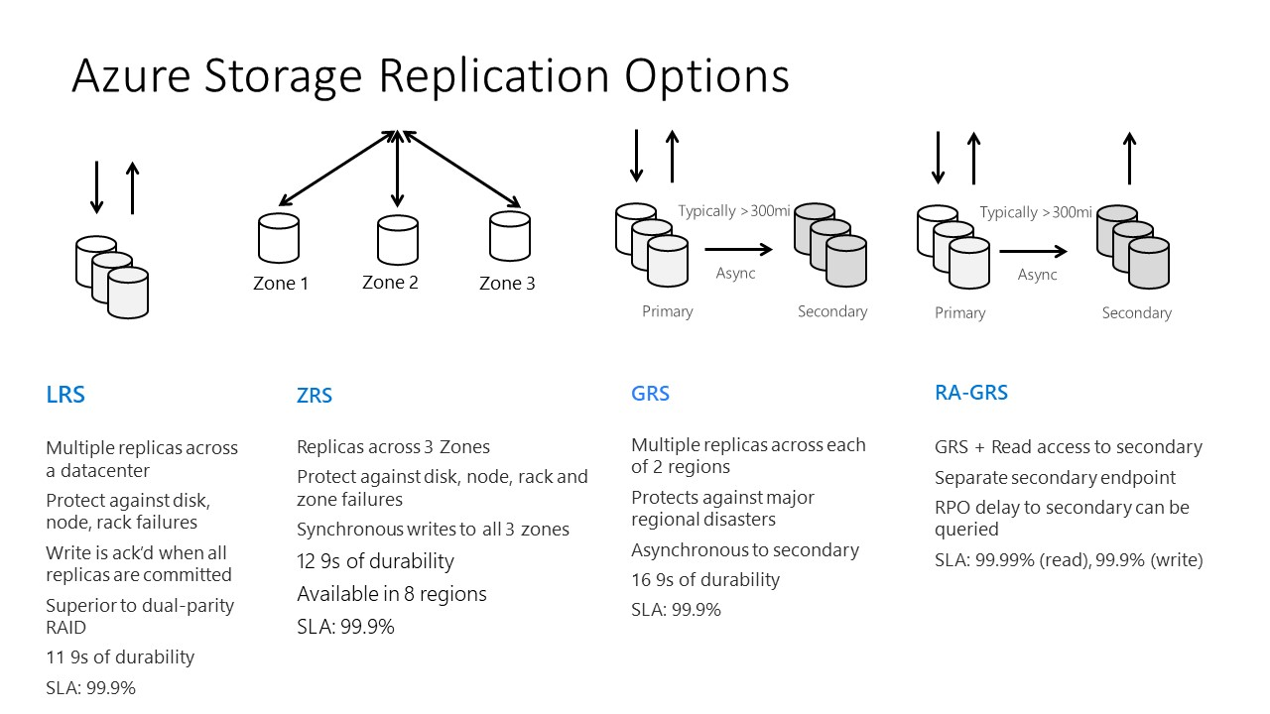
Locally redundant storage
Zone-redundant storage
Zone-redundant storage
Read-access geo-redundant storage

Slide 14
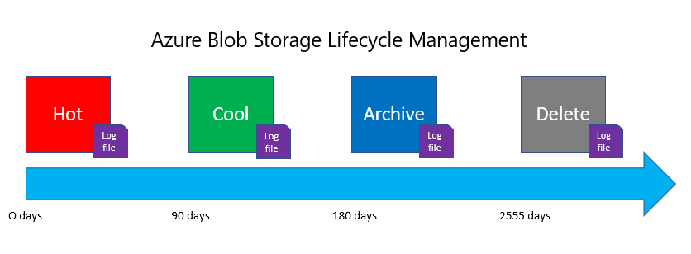
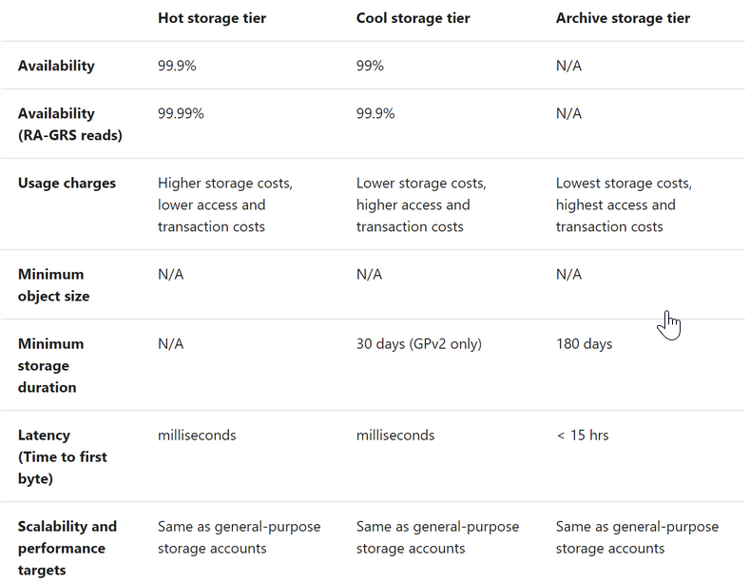

Slide 15
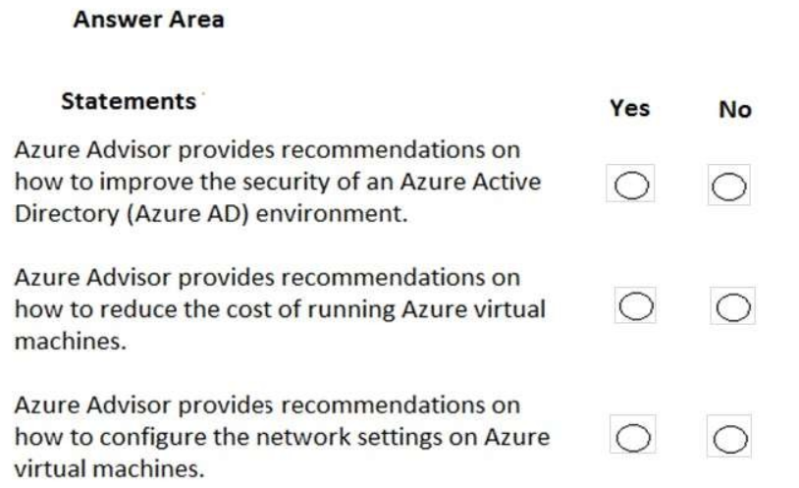
Q5

Slide 16
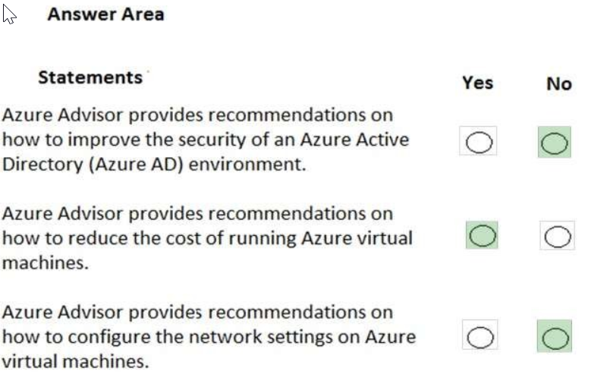
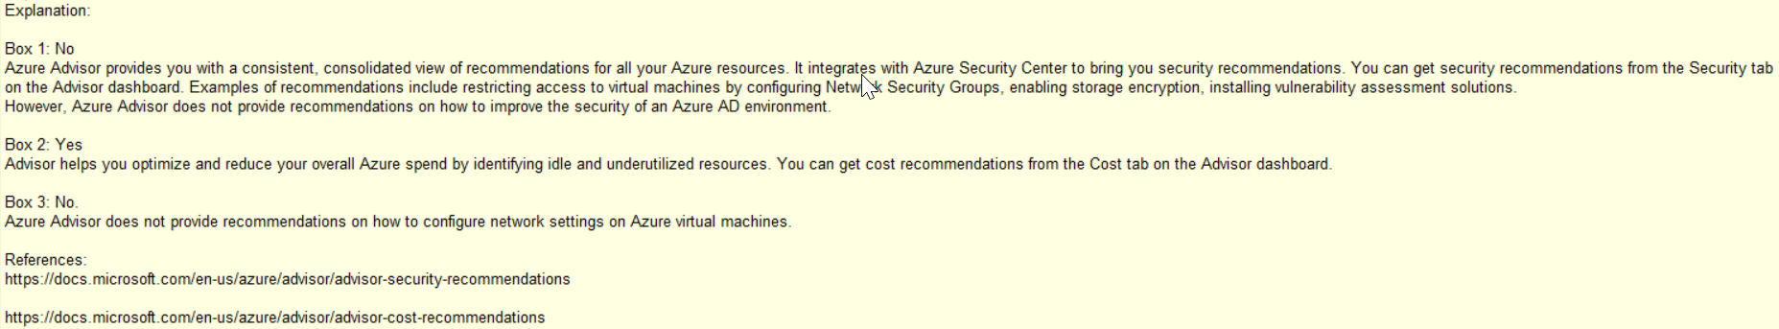
Advisor is more of a cost saving tool or resource
Management advisor.
While it can identify some security faux pauxs,
it doesn’t offer recommendations to improve Security

Slide 17
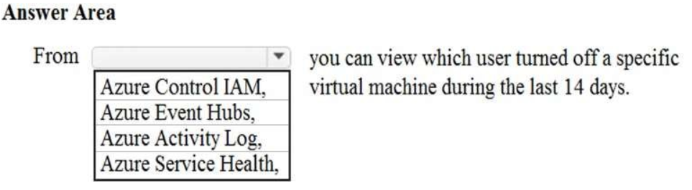
Q6
Tip: Learn what they all are
Azure Control IAM (Identity Access Management) - is used as a part of Azure Security and Access Control
to manage and control a user's identity. ... IAM best practices include policies like Single Sign-On (SSO),
Multi-factor Authentication (MFA), Role-based Access Control (RBAC), etc
Azure Event Hubs - is a big data streaming platform and event ingestion service.
It can receive and process millions of events per second.
Data sent to an event hub can be transformed and stored by using any real-time analytics provider.
Azure Activity Log – stores a summary of recent operations
Azure Service Health - is your personalized dashboard in the Azure portal for receiving notifications, guidance,
and technical support when Azure service issues, updates, or planned maintenance affect your Azure resources.

Slide 18
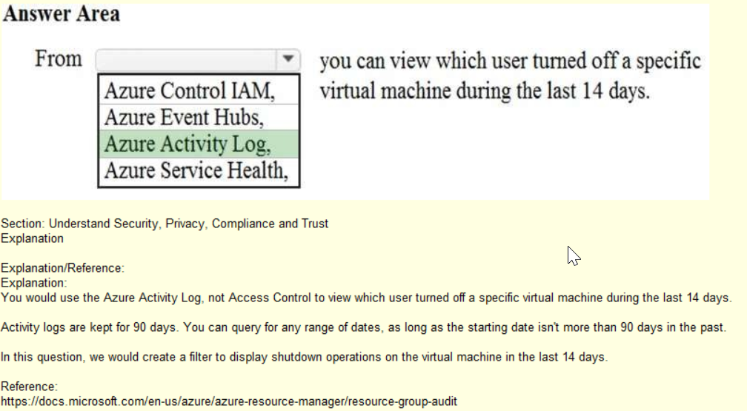

Slide 19
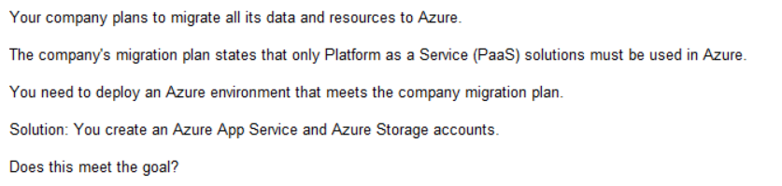
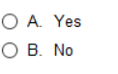
Q7
Tip: VMs OR Storage = IaaS

Slide 20
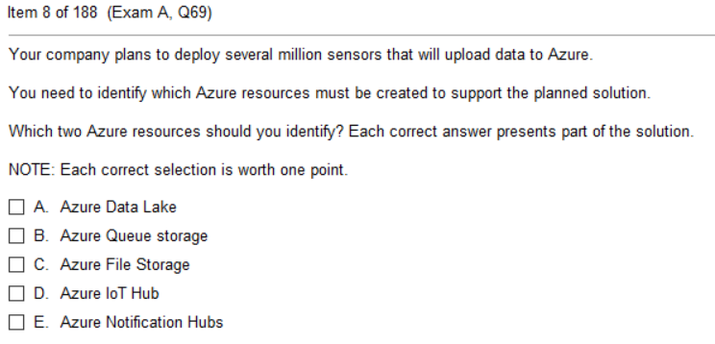
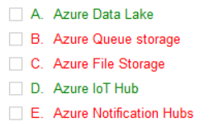
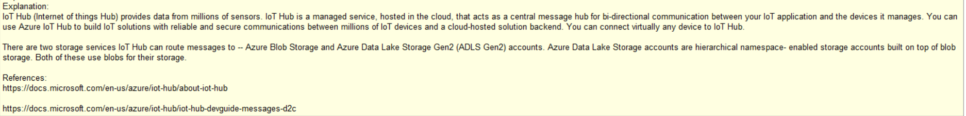
Q8

Slide 21
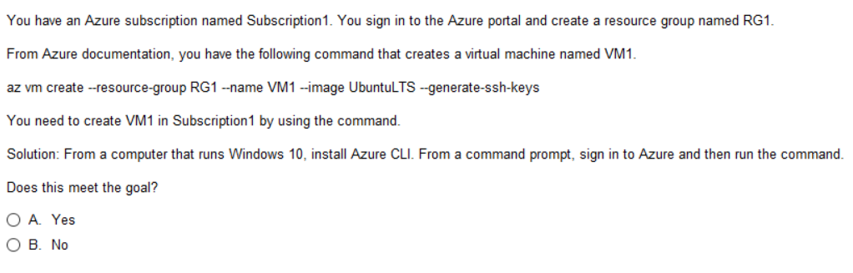
Q9
Tip: Go through all the Azure and
Run from questions in Simulator

Slide 22
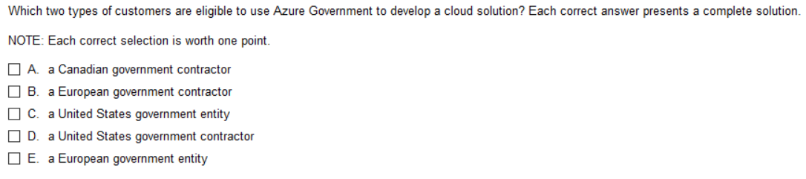
Q10
Tip: Now all about Azure Government Cloud

Slide 23
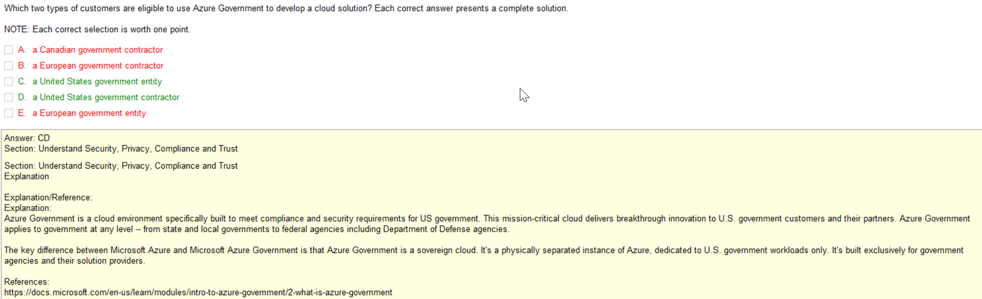

Slide 24
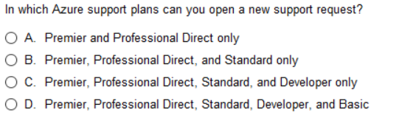
Q11

Slide 25
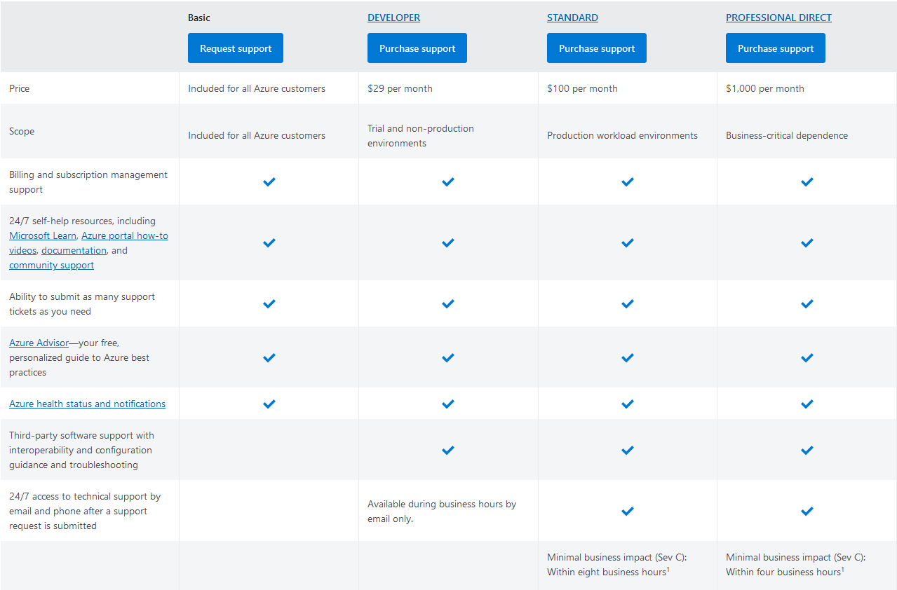

Slide 26
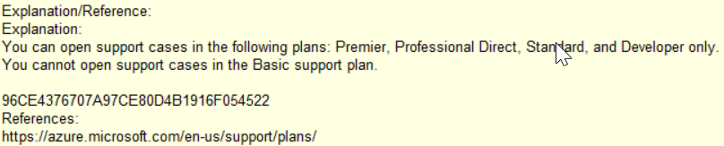

Slide 27
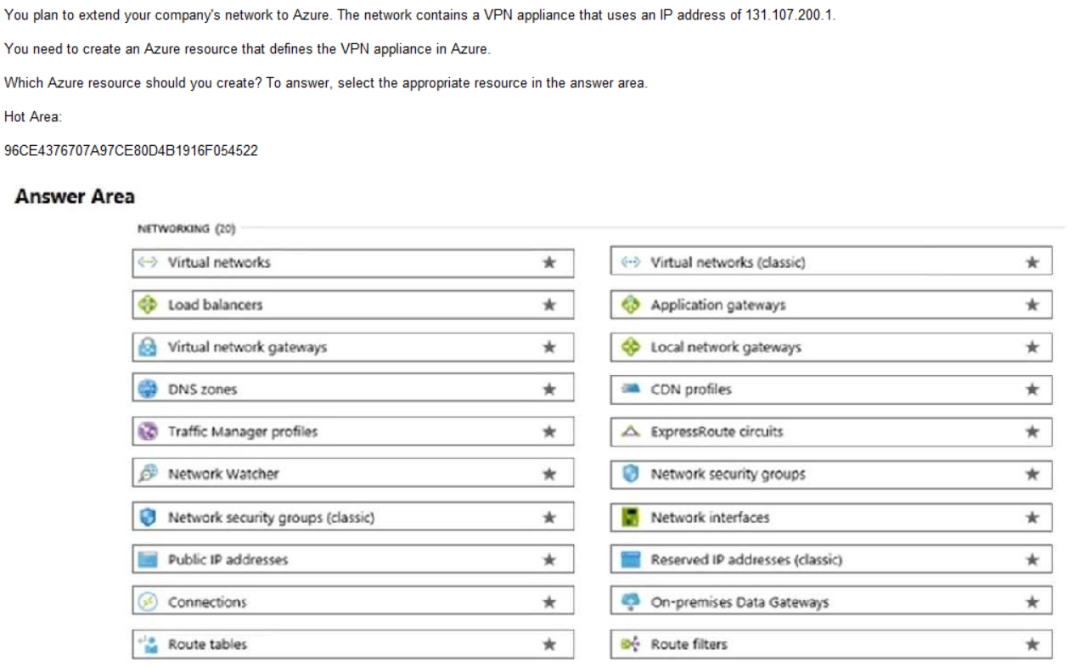
Q12

Slide 28
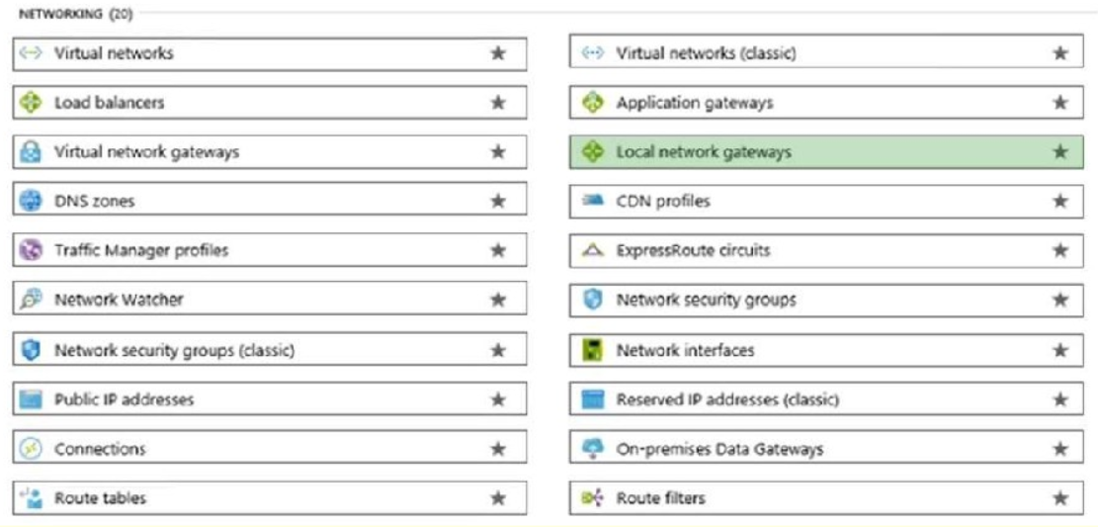
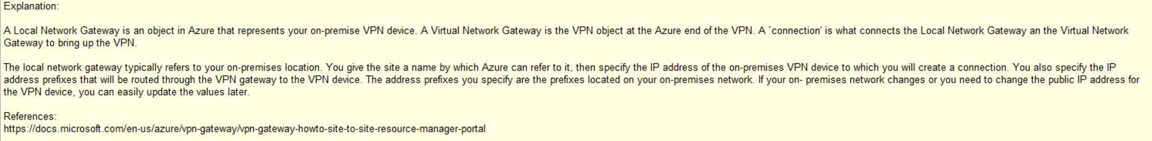

Slide 29
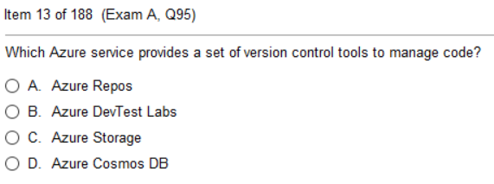
Q13

Slide 30
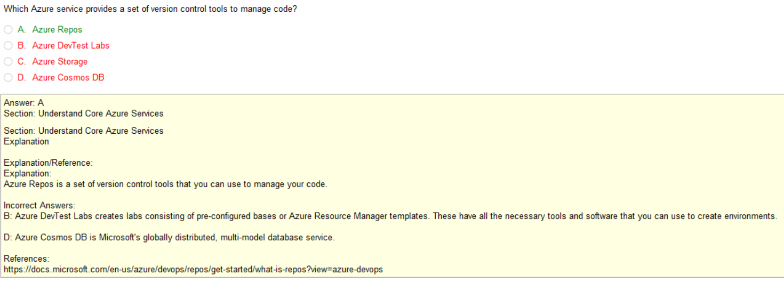

Slide 31
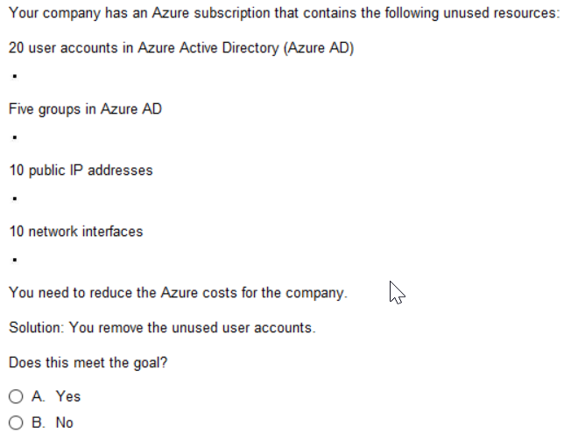
Q14
No
No
Yes
No

Slide 32
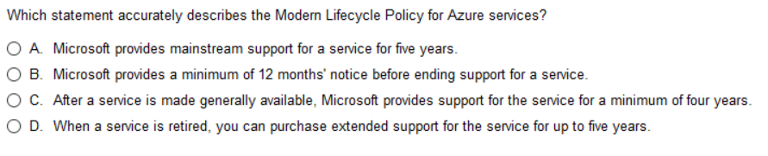
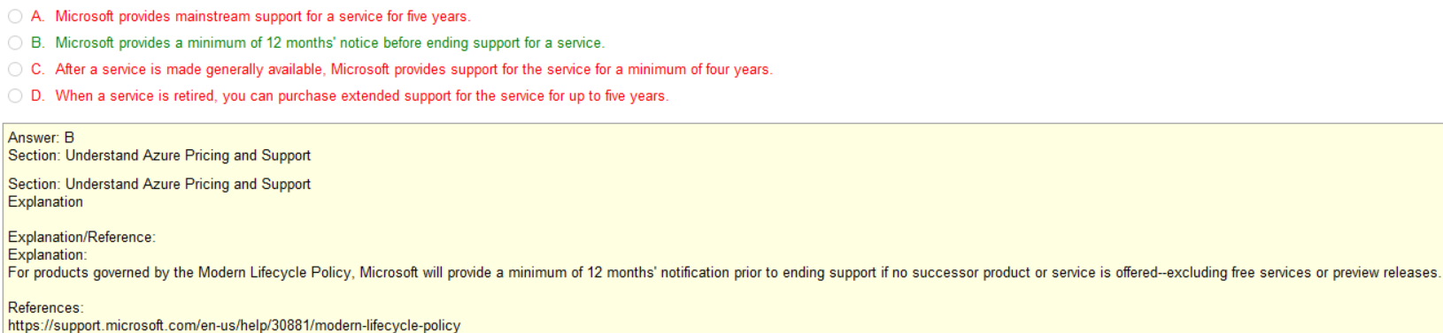
Q15

Slide 33
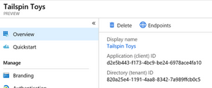
Preview
There are two types of previews, private and public.
Private preview is only available to certain Azure customers for evaluation purposes.
The public preview is available to all Azure customers.
Azure may include preview, beta, or other pre-release features, services, software, or regions offered by Microsoft to obtain customer feedback ("Previews"). Previews are made available to you on the condition that you agree to these terms of use, which supplement your agreement governing use of Azure.
Announce EOL
S
NO SLA, NO SUPPORT |
NO SLA, NO GUARANTEED SUPPORT |
SLA, SUPPORT
EOL Support
Public
Preview
Public
12 months
Private
Preview

Slide 34
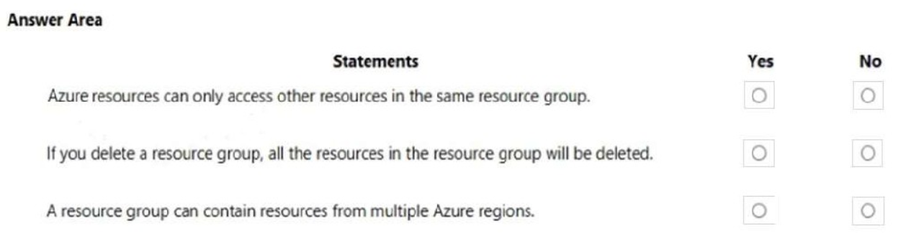
Q16

Slide 35
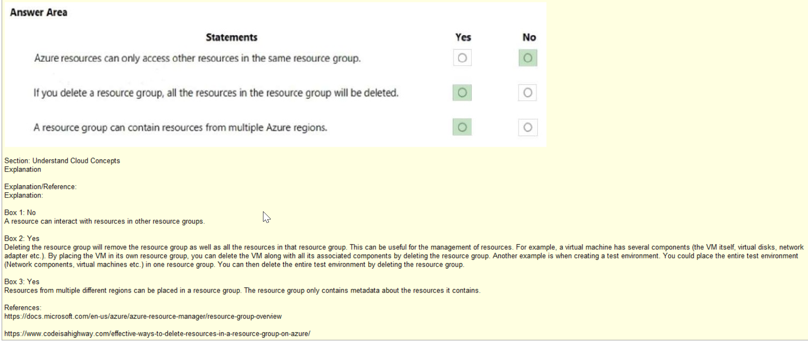

Slide 36
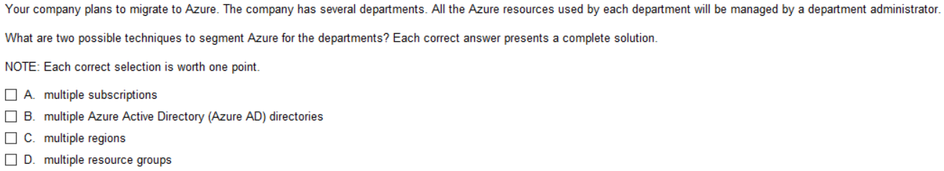
Q17

Slide 37
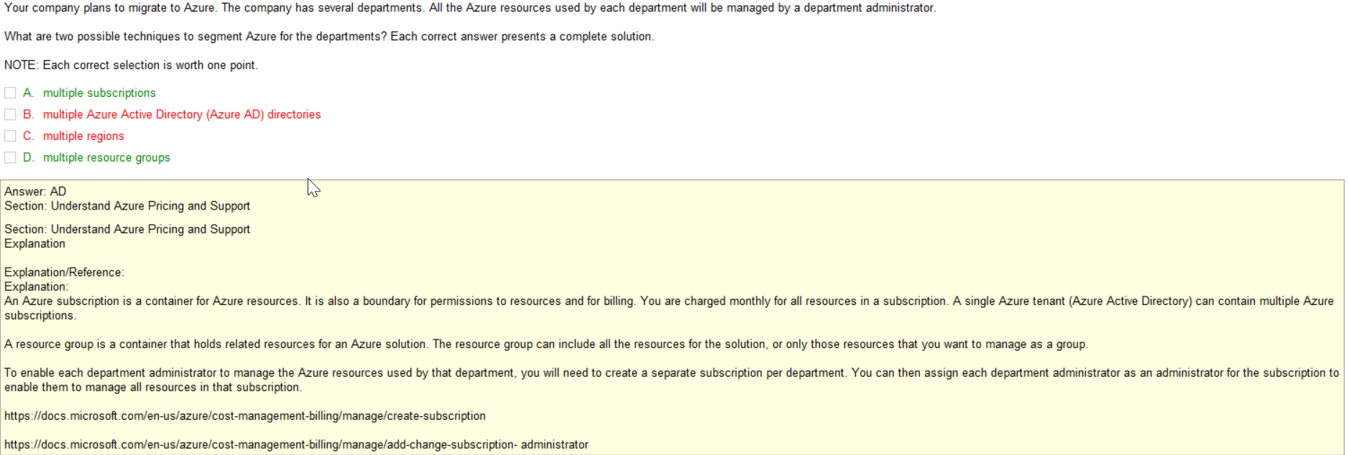

Slide 38


Q18

Slide 39

Q19

Slide 40



Slide 41


Q20
Azure Application Gateway is a web traffic load balancer that enables you to manage traffic to your web applications.
Traditional load balancers operate at the transport layer (OSI layer 4 - TCP and UDP) and route traffic based
on source IP address and port, to a destination IP address and port.
ExpressRoute is an Azure service that lets you create private connections between Microsoft datacenters
and infrastructure that’s on your premises or in a colocation facility.
A CDN (Content Delivery Network) is a highly-distributed platform of servers that helps minimize delays
in loading web page content by reducing the physical distance between the server and the user.
This helps users around the world view the same high-quality content without slow loading times.
Azure Traffic Manager is essentially a DNS server with a policy engine. The purpose of Azure Traffic Manager is to route traffic
across multiple regional data centers. This allows you to direct users to a data center that is geographically closest to them.

Slide 42


Q20

